Slide 1
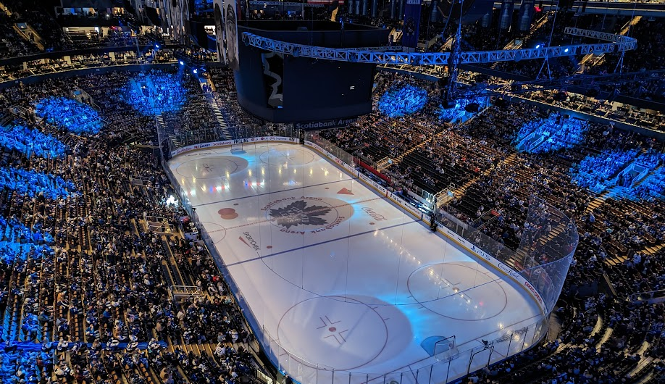
CLEANBEAM
META LENS
VENUE & MACRO
ANTENNAS

Slide 2
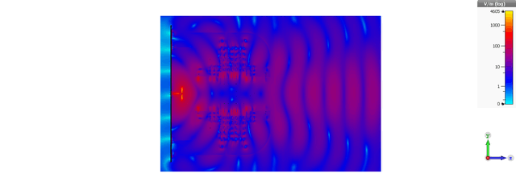
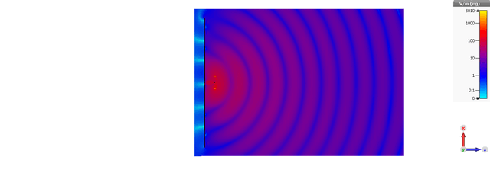
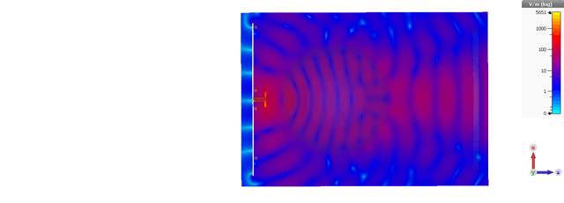
AAS metalens Technology
8dBi Gain
18dBi Gain
18dBi Gain
To be shared with close customers only
Not to be “emailed” or “left” with customers
Dipole
Dipole
Dipole
NO Lens
Dielectric Lens
AAS Lens
90% AIR
Dipole
Dipole
Dipole

Slide 3
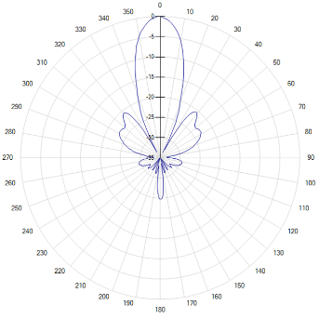
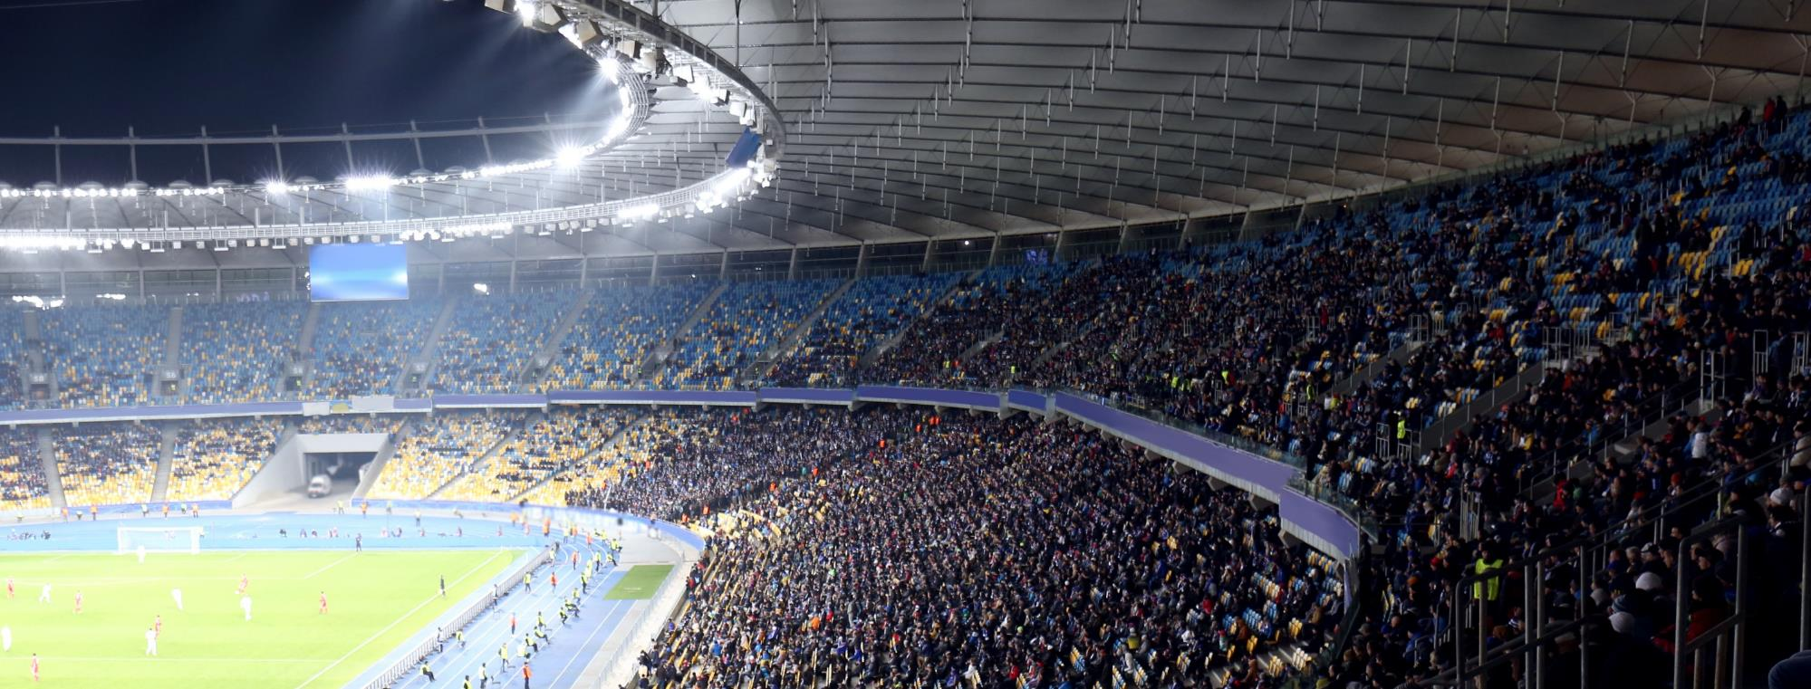
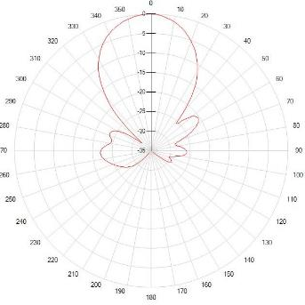
Single Beam Antennas
Sharp Roll-Off, Low-Sidelobes 17°x 17° & 35°x 35°

Slide 4
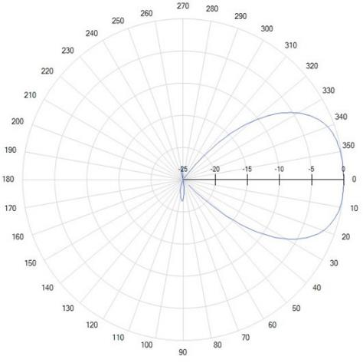
Single Beam Antennas
Ultra sharp roll-off, Shaped “Square” beam 50° x 50°

Slide 5
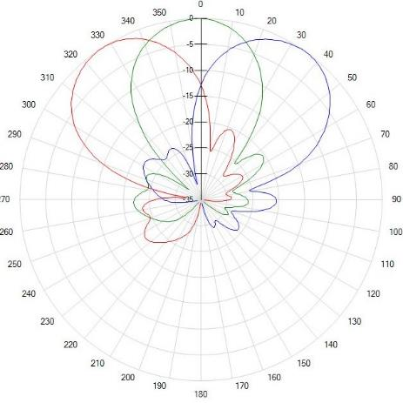
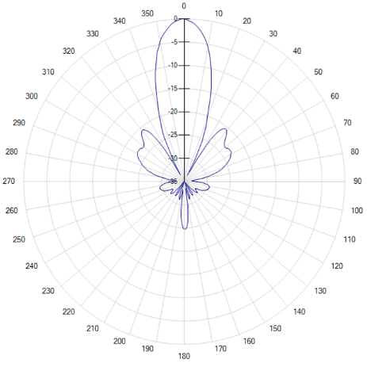
Cluster Beam Antennas
Fixed Tilt 4-beam

Slide 6
Cluster Beam Antennas
RET-Adjustable 4-beam

Slide 7
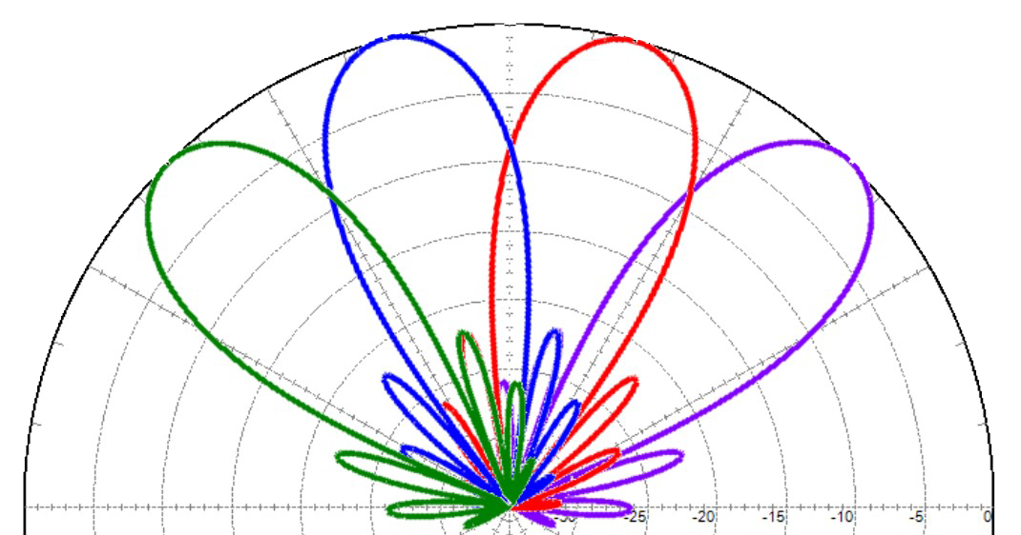
MultiBeam Antennas
4-beam RET

Slide 8
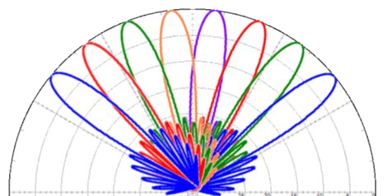
MultiBeam Antennas
8-beam RET

Slide 9
MULTI-BEAM ANTENNAS
12-BEAM RET
THIS SLIDE IS NOT COMPLETE

Slide 10
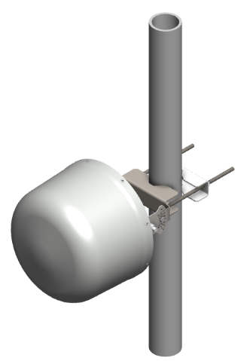
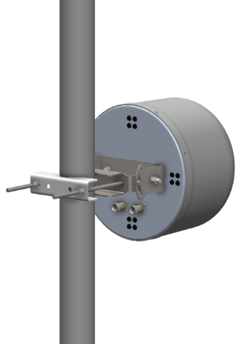
V17-001-01-A0
2T2R Lens Antenna 17°x 17°
ELECTRICAL SPECIFICATIONS
Frequency Range (MHz) | 3300-4000
 | 3300-3550 | 3550-3700 | 3700-4000
Polarization | ±45°
Gain (dBi) | 18.5 ± 0.2 | 18.4 ± 0.1 | 18.5 ± 0.4
Azimuth Beamwidth | 18.5° ± 1° | 17° ± 1° | 16° ± 0.5°
Elevation Beamwidth | 18.5° ± 1° | 17° ± 1° | 16° ± 0.5°
VSWR (Return Loss dB) | 1.5:1 (-14)
Front-to-Back Ratio, 180° ± 30° (dB) | > 30 | > 30 | > 30
Sidelobe (dB) | > 18 | > 18 | > 18
Isolation (dB) | > 25
MECHANICAL SPECIFICATIONS
Length | 280 mm (11.0 in)
Width | 280 mm (11.0 in)
Depth | 276 mm (10.9 in)
Weight | 3.1 kg (6.9 lb)
Connector Type | (2x) 4.3-10 Female

Slide 11
V35-001-01-A0
2T2R Lens Antenna 35°x 35°
ELECTRICAL SPECIFICATIONS
Frequency Range (MHz) | 3300-4000
 | 3300-3550 | 3550-3700 | 3700-4000
Polarization | ±45°
Gain (dBi) | 11.9 ± 0.2 | 12 ± 0.2 | 12.5 ± 0.7
Azimuth Beamwidth | 41° ± 2° | 40° ± 2° | 36° ± 3°
Elevation Beamwidth | 41° ± 2° | 40° ± 2° | 36° ± 3°
VSWR (Return Loss dB) | 1.5:1 (-14)
Front-to-Back Ratio, 180° ± 30° (dB) | > 25 | > 25 | > 25
Sidelobe (dB) | > 16 | > 17 | > 18
Isolation (dB) | > 25
MECHANICAL SPECIFICATIONS
Length | 120 mm (4.7 in)
Width | 120 mm (4.7 in)
Depth | 120 mm (4.7 in)
Weight | TBD
Connector Type | (2x) 4.3-10 Female

Slide 12
V50-001-01-A0
Sharp Roll-Off 2T2R Lens Antenna - 50° x 50°
ELECTRICAL SPECIFICATIONS
Frequency Range (MHz) | 3300-4000
 | 3300-3550 | 3550-3700 | 3700-4000
Polarization | ±45°
Gain (dBi) | 10.9 ± 0.5 | 11 ± 0.2 | 11.5 ± 0.6
Azimuth Beamwidth | 49° ± 2° | 50° ± 1° | 51° ± 1°
Elevation Beamwidth | 49° ± 2° | 50° ± 1° | 51° ± 1°
VSWR (Return Loss dB) | 1.5:1 (-14)
Front-to-Back Ratio, 180° ± 30° (dB) | > 25 | > 25 | > 25
Sidelobe (dB) | > 15 | > 16 | > 17
Isolation (dB) | > 25
MECHANICAL SPECIFICATIONS
Length | 260 mm (10.3)
Width | 260 mm (10.3)
Depth | 150 mm (5.9)
Weight | TBD
Connector Type | (2x) 4.3-10 Female

Slide 13
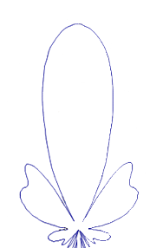
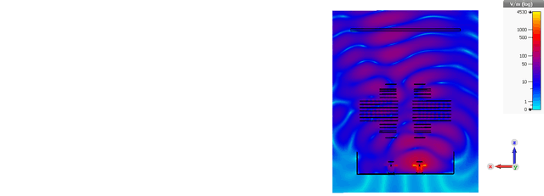
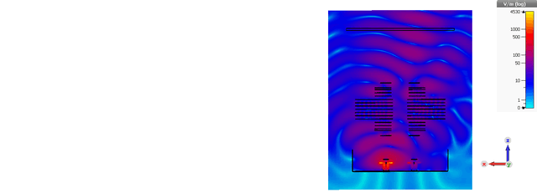
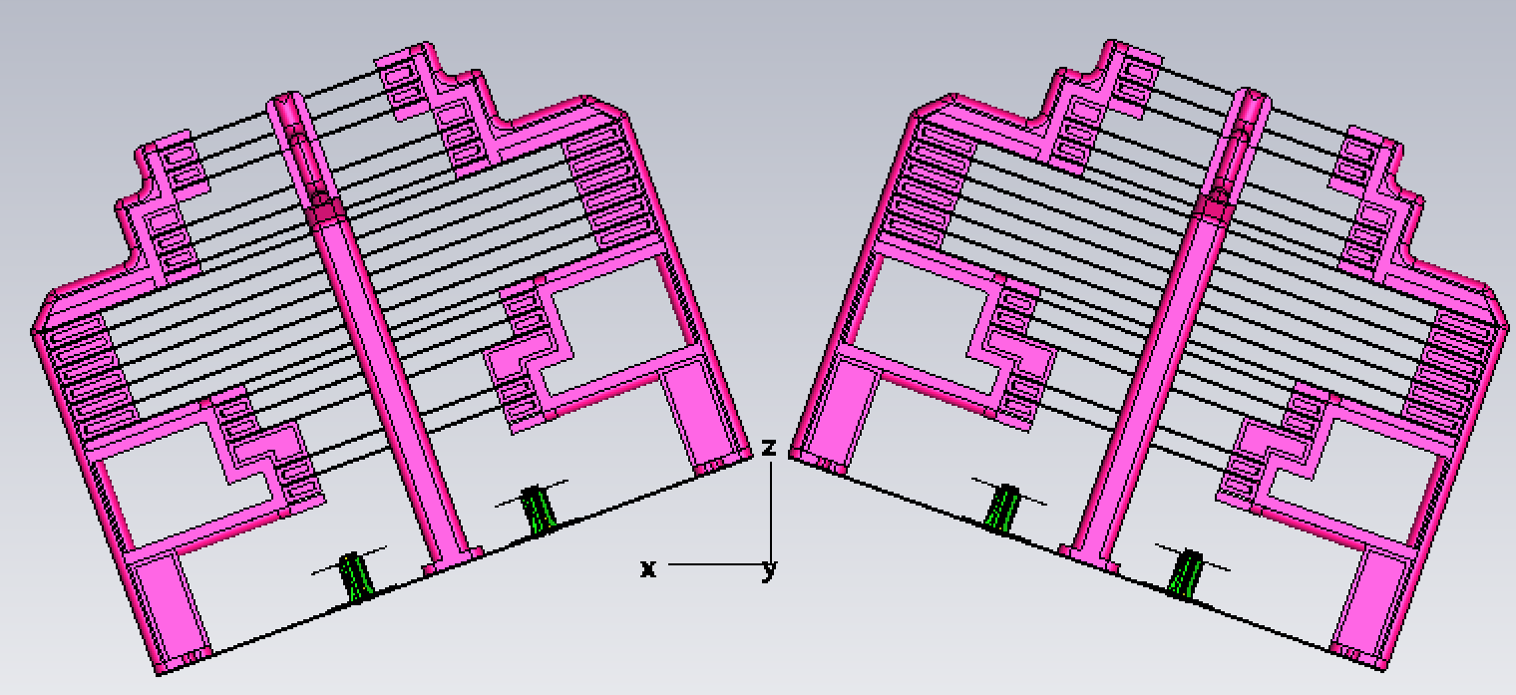
AAS 4-beam Macro
concept

Slide 14
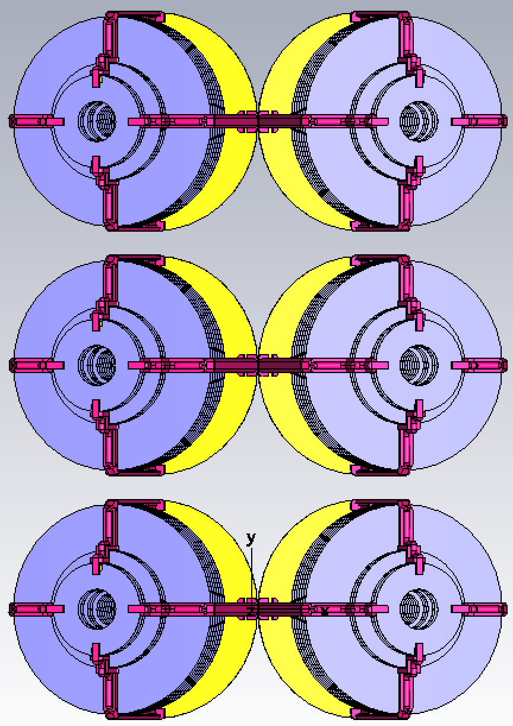
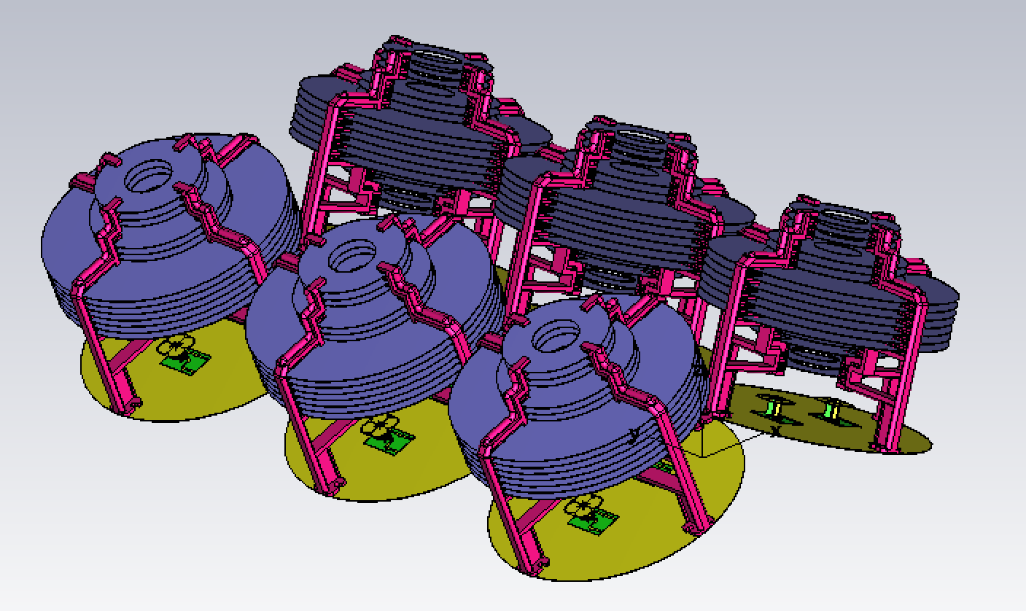
AAS 4-beam Macro
17° HBW
8.5° VBW
0° - 12° EDT
concept

Slide 15

AAS 4-beam Macro
CONCEPT

Slide 16
AAS 4-beam Macro
Advantages
Better capacity solution than 64T64R with 8T8R radio configured into split sector mode
  Purely symmetric 4 beams with very low sidelobes
  No gain loss due to array scanning
  No grating lobes due to array scanning
Adjustable beam pairs
Ultra low loss / high gain beams
  No lossy RF PCB matrix to generate multiple beams
  Simple, low-loss phase shifter to generate tilt

Slide 17
CLEANbEAM ROADMAP 2024-2025
Sept 2024
Oct 2024
Dec 2024
Q1 2025
Q2 2025
C-Band
V17-001-01-A0
17x17
Single Beam
V50-001-01-A0
50x50
Square Beam
V35-001-01-A0
35x35
Single Beam
V35-001-04-A0
35x35
Cluster Beam
M4-004A-LA0
Multi-Beam
V35-001-04-A1
35x35 RET
Cluster Beam
M8-008A-LA0
Multi-Beam
Mid-Band
V35-001-01-A0
35x35 Single Beam
V17-010-01-A0
17x17 Single Beam
V50-010-01-A0
50x50 Square Beam
V35-010-04-A0
35x35 Cluster Beam
V50-011-01-A0
50x50 Square Beam
V35-011-01-A0
35x35 Single Beam
V35-011-04-A0
35x35 Cluster Beam
V17-011-01-A0
17x17 Single Beam
MX-048A-LA0
Multi-Beam

