Slide 1
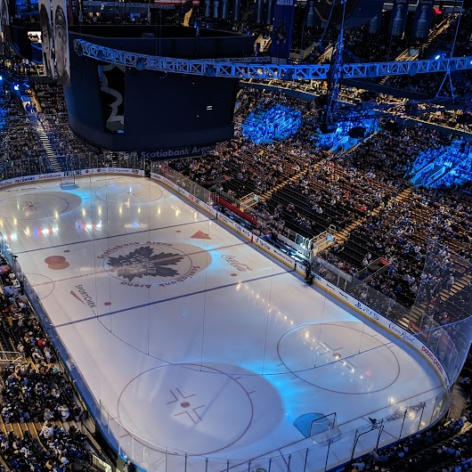
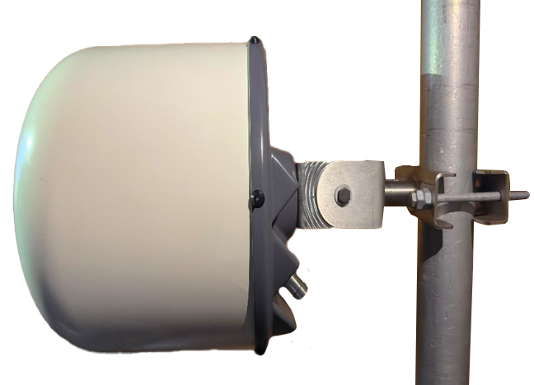
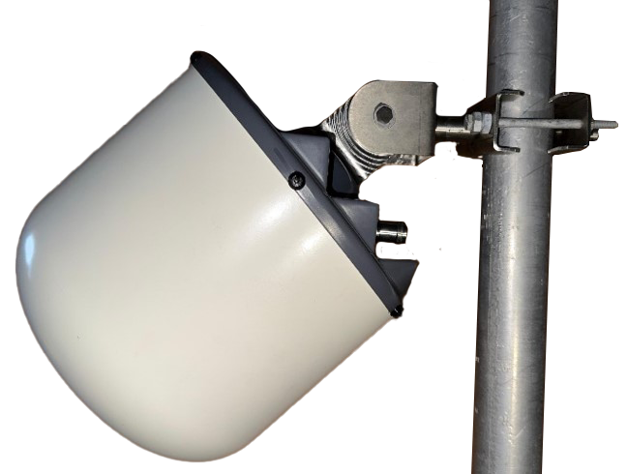
INTRODUCING AMPHENOL ANTENNAS NEW
VENUE AND STADIUM ANTENNA SERIES
CleanBeamTM

Slide 2
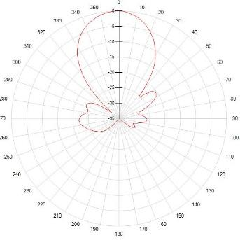
VENUE AND STADIUM ANTENNAS
SINGLE BEAM 17°x17° and 35°x35°
With Low Sidelobes and Sharp Roll-Off
CleanBeamTM
CleanBeamTM

Slide 3
VENUE AND STADIUM ANTENNAS
SHAPED “SQUARE” BEAM
50°x50° with Ultra-Sharp Roll-Off
CleanBeamTM

Slide 4
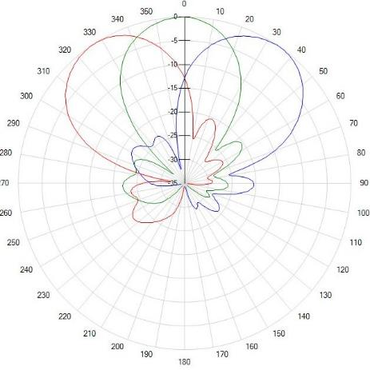
VENUE AND STADIUM ANTENNAS
CLUSTER 4-BEAM
Fixed Tilt
CleanBeamTM

Slide 5
CleanBeamTM

Slide 6
CleanBeamTM

Slide 7
CleanBeamTM

Slide 8
CleanBeamTM

