Slide 1
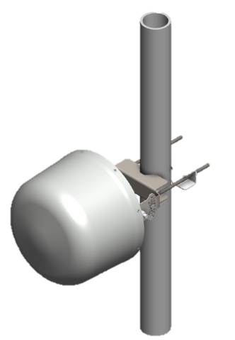
Get Ready! Amphenol is unleashing even Greater Connectivity

Slide 2
Get Ready! Amphenol is unleashing even Greater Connectivity

